Slide 1
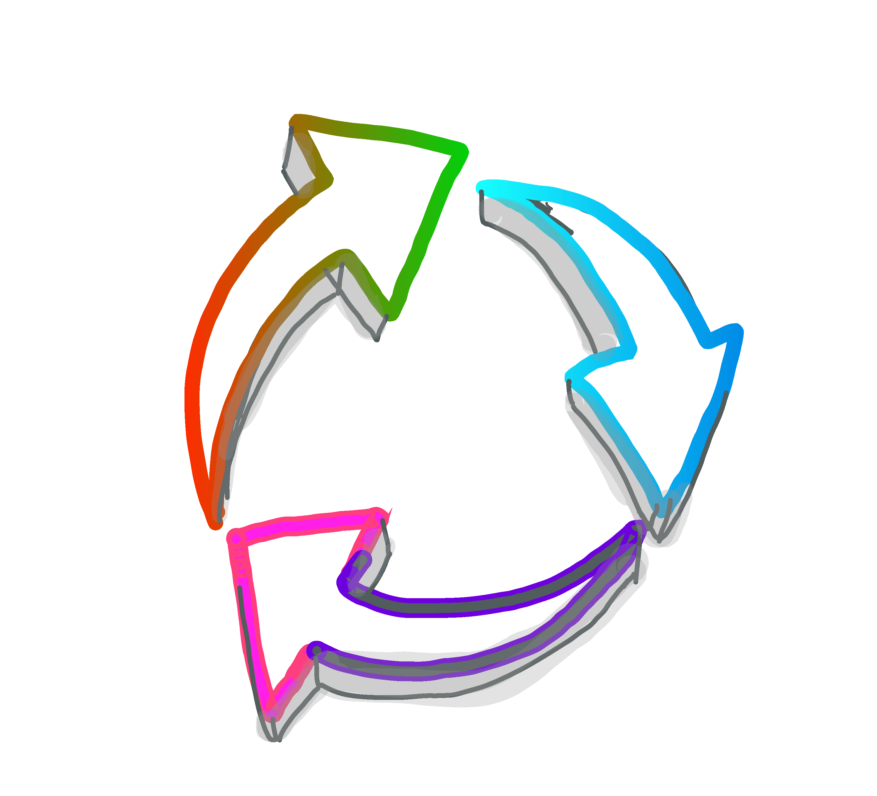
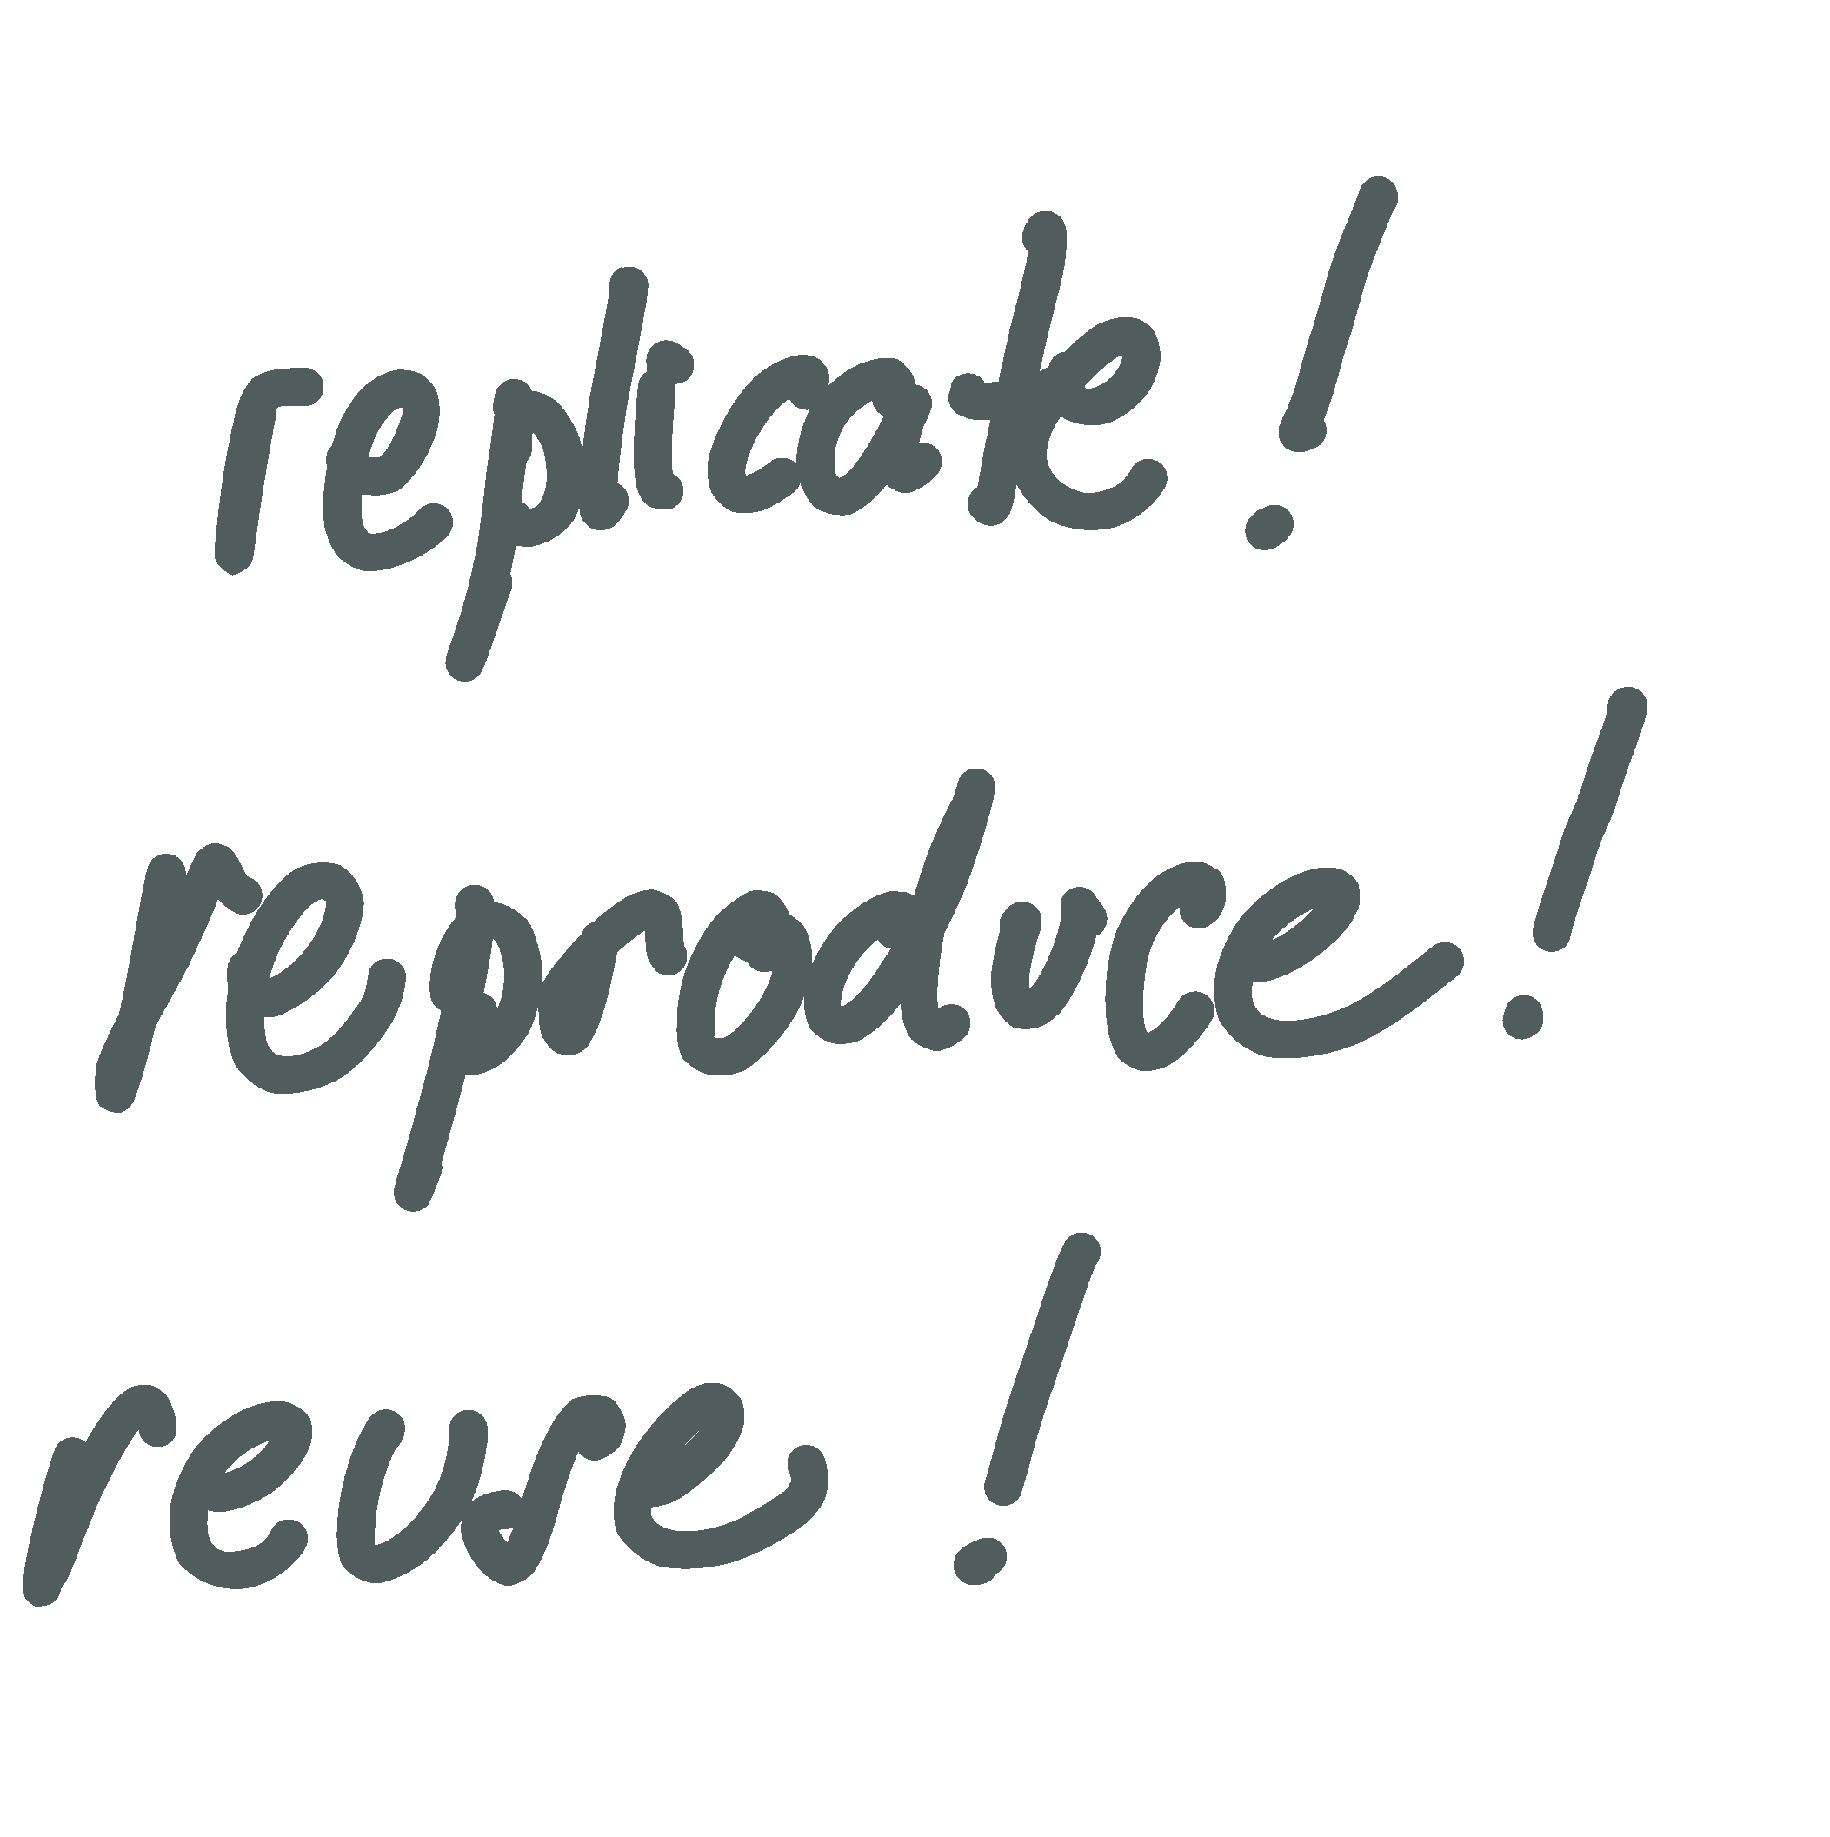
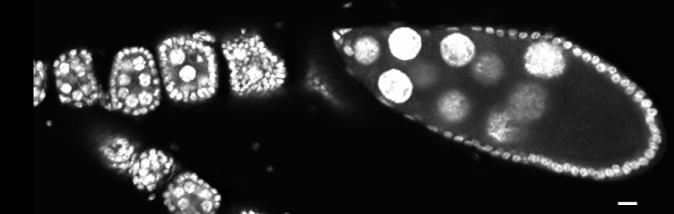
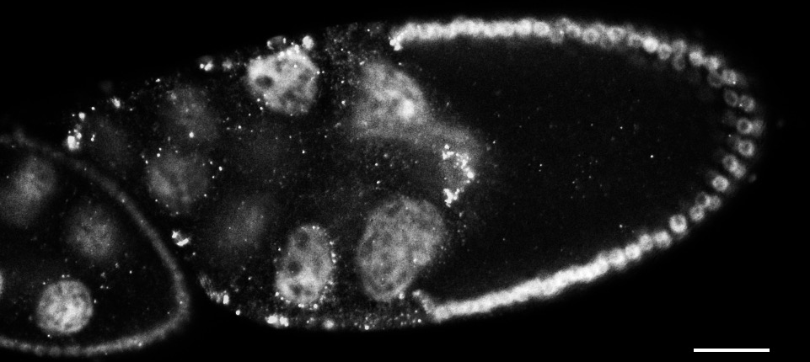
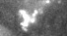




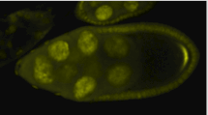
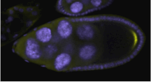
Reproducible presentation of images Author Helena Jambor, TU Dresden/Germany, Tuan Tran, ….. Presenter Presenter name, affiliation here
Why is reproducibility important for image data?
Digital images are just data and therefore easily manipulated.
Why do I need to bother about image legibility?
Images must be universally understandable to all audiences, now and in future.
What do I need to consider when doing quantitative imaging?
Images that are analyzed quantitatively need special care during the acquisition process.
All digital images are just numbers and thus easy to changes. At increasing frequency, images are submitted for publications that have unintentional and intentional mistakes. It is currently estimated that 4% of published papers have problematic images (Bik, 2016).
Images are: photographs, micrographs, EM images, movies.
Image reproducibility means that all audiences can understand and potentially replicate the image. Audiences include scientists around the globe, across disciplines, the public, and future readers.
Only use dyes where signal is linearly correlated with material. Many dies are not linear and can’t be used for quantification.
Only with loss-less file fomats. Reversion from compressed to rich format is not possible, see en.wikipedia.org/wiki/Image_file_formats
Be careful with exposure time/filter/lamps No change during an experiment and use the dynamic range of your camera when imaging. See: Claire Brown doi: 10.1242/jcs.022079
Magnification, binning Pick lens + image resolution you need to answer biological question. Too long imaging can cause bleaching/toxicity.
How can I prepare legible images?
Steps towards legible images:
What are image manipulations and how can I avoid them?
Easy steps to avoid image manipulations:
Choose magnification
The magnification of images must fit your research question. All parts of the images that answer this question need to be visible.
Focus on tissue Focus on cells Focus on subcellular
Decide whether to use color
Color can convey information, focus attention, or help distinguish. If none of these apply: do not use color. Also, greyscale has much better contrast than multiple colors. Choose wisely!
Make colors accessible to everybody
Some people are color-blind, some people can’t distinguish similar shades.
Add labels for key features if necessary
Add title and scale information
Which tools are available for image processing?
Keep raw original and only adjust copies.
Compare only images that are acquired and processed identically.
Don’t use lossy compression to save images.
Report method of sample preparation, image acquisition, and image processing.
Acceptable manipulations:
Linear adjustment of brightness/contrast for entire image.
Cropping to a region of interest (ROI)
Be careful: software filters that improve image quality and nonlinear adjustments, e.g. gamma settings
Non-acceptable manipulation:
Specific features in images are enhanced, obscured, moved, removed, or introduced.
Combinations of multiple images into one!
Image processing must be transparent and interpretable by a larger community. Efforts to image with open microscopy environment (OME), and process images with open processing algorithms is key, e.g. FIJI.
Image repositories: clouds and public databases.
✔
.png .tiff .ome
✗
.pdf .jpg .ppt
Images in papers are compressed and can’t be re-analyzed quantitatively. To permit a later reuse, e.g. with improved software, store the raw images in public databases. (see also Ellenberg et al 2018)
Store also information on: sample type & preparation method, basic annotation, acquisition method.
Deposit your images
https://zenodo.org/ free online repositories that provides DOI. Upload limit 50GB per dataset. Supported by CERN, EU
https://figshare.com/ free online repository to store & share data, provides DOI, upload limit: 5GB per file.
Normal color vision Color blind vision (Deuteranopia)
Further reading
Not color-blind save
Color-blind save
Cromey, D.W. 2010. Sci Eng Ethics. Avoiding twisted pixels: ethical guidelines for the appropriate use and manipulation of scientific digital images, doi.org/10.1007/s11948-010-9201-y
Rossner M., Yamada K. 2004. JCB. What’s in a picture? the temptation of image manipulation. 10.1083/jcb.200406019
Rossner M. 2006. The scientist. How to guard against image fraud.
Ellenberg, J et al. 2018. Nature methods. A call for public archives for biological image data.
doi.org/10.1038/s41592-018-0195-8
Bik et al. 2019. mBIO. The prevalence of inappropriate image duplication in biomedical research publications.
Training: UAB Center for Ethics and Values in the Sciences
https://ori.hhs.gov/education/products/RIandImages/default.html
Journal guidelines: http://www.aje.com/en/arc/avoiding-image-fraud-7-rules-editing-images/
Training also regularly offered by neubias (network of european bioimage analysts)
Notes:
Reserve the color for the orientation, ie the boxes with the questions (Which color code we can still discuss…)
Remove the “” as it creates clutter, I used italic light for the question and immediately below bold regular for the answer. Basically, one shuod be able to just read the answers as the titles in each section..
Stick to one layout: 3 columns, then to not split middle one in half half-way down.
Outline: >listed here for us to discuss the outline step by step.<
Different datasets can lead to same graoh
Bar graph for non-nomal data
Alternative plot forms
Are dot plots hard to read? How to read a dot plot.
Show summary statistics.. When?
How to add data points to my bar
Box plots for bimodal
How I did my analysis influences the plot type
`Design figures
Effective box or violin plots wth dots…
Encourage others.

